Slide 1



Dr. Hiba Shakir Ahmed
Microbiology / Clinical Immunology

Slide 2
Pathogenesis of virus
Lecture 2

Slide 3
Pathogenesis
Viral pathogenesis: is the process that occurs when a virus infects a cell and causes cellular changes.
Disease pathogenesis: is a subset of events during an infection that results in disease manifestation in the host.

Slide 4
Steps in Viral Pathogenesis
Specific steps involved in viral pathogenesis are the following: viral entry into the host, primary viral replication, viral spread, cellular injury, host immune response, viral clearance or establishment of persistent infection, and viral shedding.

Slide 5
B. Viral Spread and Cell Tropism
Some viruses, such as influenza viruses (respiratory infections) and noroviruses (gastrointestinal infections), produce disease at the portal of entry and typically do not spread systematically. Others can spread to distant sites (eg, cytomegalovirus [CMV], HIV, rabies virus) and cause additional disease manifestations . Mechanisms of viral spread vary, but the most common route is via the bloodstream or lymphatics. The presence of virus in the blood is called viremia. Virions may be free in the plasma (eg, enteroviruses, togaviruses) or associated with particular cell types (eg, measles virus) . Viruses may multiply within those cells (eg, Epstein-Barr virus [EBV] is lymphotrophic.
A. Entry and Primary Replication
Most viral infections are initiated when viruses attach and enter cells of one of the body surfaces—skin, respiratory tract, gastrointestinal tract, urogenital tract, or conjunctiva.

Slide 6
C. Cell Injury and Clinical Illness
Destruction of virus-infected cells in the target tissues and physiologic alterations produced in the host by the tissue injury are partly responsible for the development of disease.
Some tissues, such as intestinal epithelium, can rapidly regenerate
and withstand extensive damage better than others, such as the brain.
D. Recovery from Infection
Following a viral infection, the host will succumb, recover, or establish a chronic infection. Recovery mechanisms include both innate and adaptive immune responses. Interferon (IFN) and other cytokines and possibly other host defense factors are involved. The relative importance of each component differs with the virus and the disease.

Slide 7
E. Virus Shedding
The last stage in pathogenesis is the shedding of infectious virus into the environment. This is a necessary step to maintain a viral infection in
populations of hosts. Shedding usually occurs from the body surfaces involved in viral entry.

Slide 8
Viral Virulence
Virulence refers to the capacity of a virus to cause disease in an infected host. It is a quantitative statement of the degree or extent of pathogenesis. In general, a virulent virus causes significant disease, whereas an avirulent or attenuated virus causes no or reduced disease, respectively.
Virulence depends on
-Dose
-Virus strain (genetics)
- Inoculation route - portal of entry
-Host factors - eg. Age SV in adult neurons goes persistent but is lytic in young

Slide 9
Measuring Viral Virulence
Virulence can be quantified in a number of ways. One approach is to determine the concentration of virus that causes death or disease in 50% of the infected animals. This parameter is called the 50% lethal dose (LD50), the 50% paralytic dose (PD50), or the 50% infectious dose (ID50), depending on the parameter that is measured.
Other measurements of virulence include :
1- mean time to death or appearance of symptoms
2- measurement of fever or weight loss.

Slide 10
Virus-induced tissue damage can be measured directly by :
-examining histological sections or the blood.
The safety of live attenuated poliovirus vaccine is determined by assessing the extent of pathological lesions in the central nervous system in experimentally inoculated monkeys.
- The reduction in blood concentration of CD4+ lymphocytes caused by human immunodeficiency virus type 1 infection is another example. Indirect measures of virulence include assays for liver enzymes (alanine or aspartate amino-transferases) that are released into the blood as a result of virus-induced liver damage .

Slide 11
Immunity of virus
natural immunity to viral infections is associated with interferons especially α and β so called because of their interference with viral replication .
γ is probably most effective in protecting against extracellular bacteria though its ability to enhance immune-mediated mechanisms .
since viruses require attachment to host cells before they can replicate and cause infection , antibodies to the virus that prevent attachment represent an important mechanism that protect against viral infection. these protective antibodies may be IgG or IgA as in the case of polio prevention .
since viruses replicate in cells where they are no longer exposed to circulating antibodies , their eradication depends upon killing the infected host cells . this of course this require a CTL response .
as virally infected cells usually express viral peptides in MHC class I on their surface , they become targets for destruction by cytotoxic CD8 T cells . cells infected by virus also become susceptible to killing by NK cells . in this way viral replication is prevent and the viral infection eliminated.

Slide 12
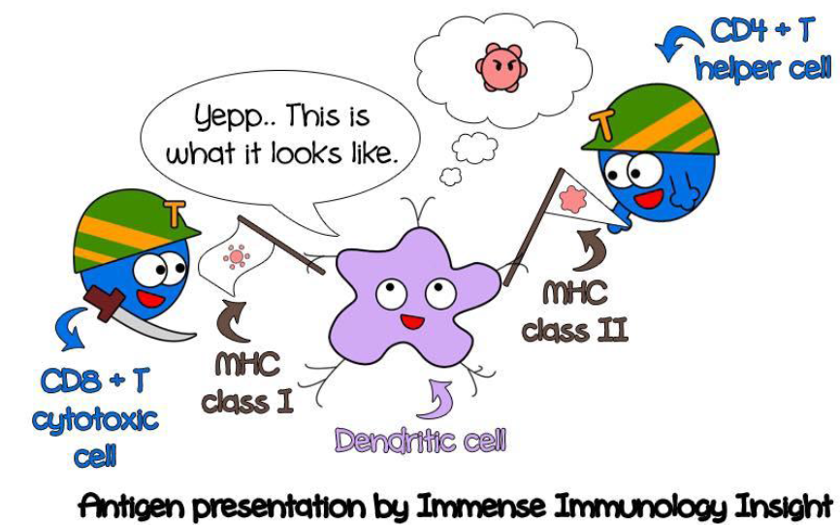

Slide 13


